Slide 1




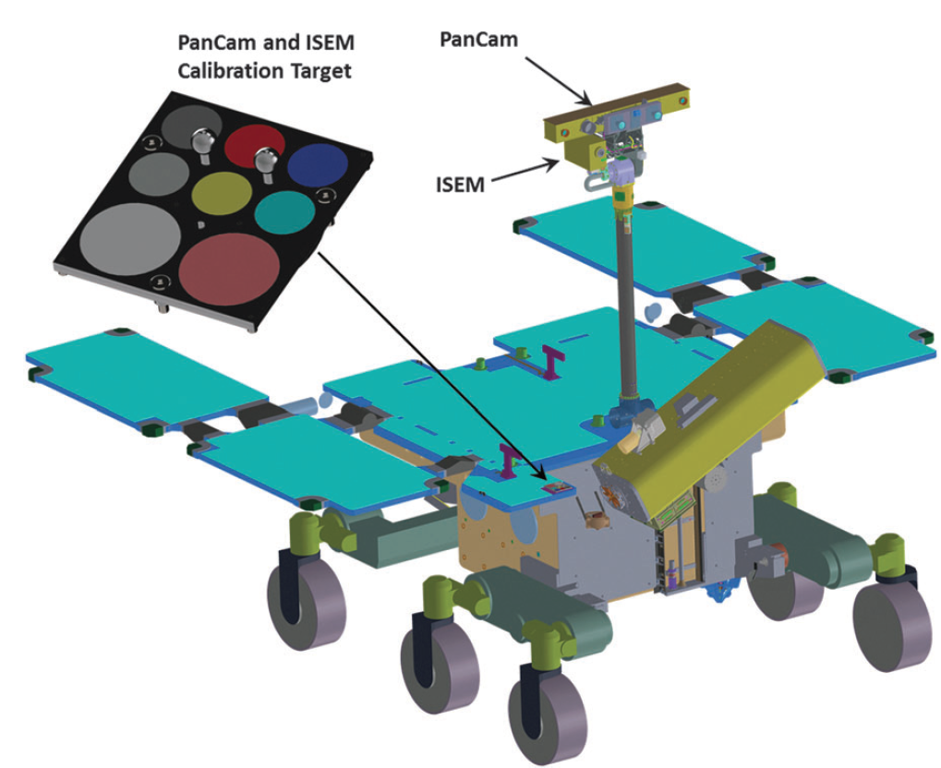
ISEM (Infrared Spectrometer for ExoMars)
NII MicroPriborov
O. Korablev (PI), Y. Dobrolenskiy (IM) and the ISEM Team
IKI - Space Research Institute, Moscow
Vernadsky Institute of Geochemistry and Analytical Chemistry, Moscow
NII MicroPriborov Guskova - Zelenograd

Slide 2
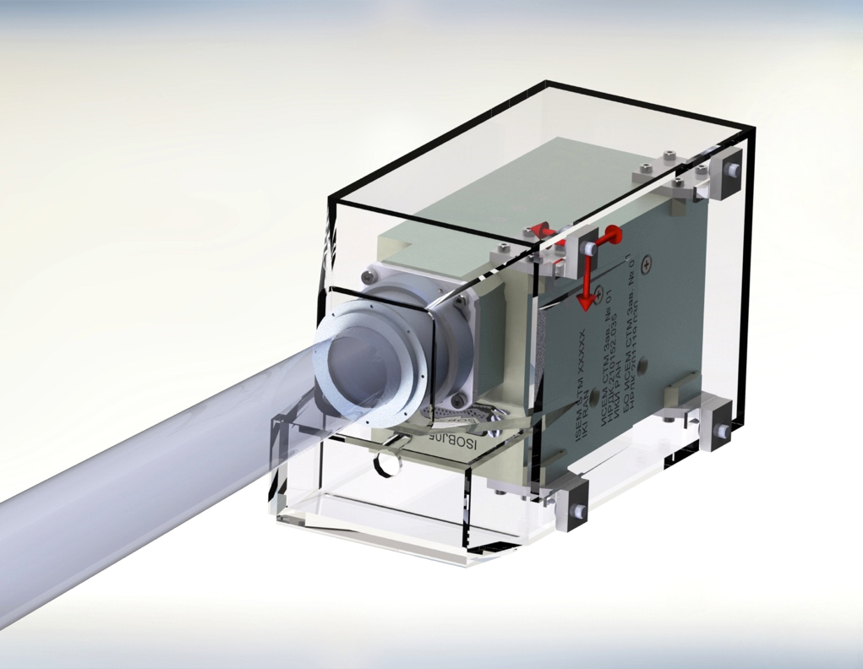
Instrument accommodation. Optical box
ISEM optical box
  Spectral range
  1.1-3.3 µm
  FOV 1°
HRC: high-resolution camera
  FOV 5°
Notes:
MLI design was updated. During STM delivery we received few comments on MLI design. Pictures will be updated in few weeks

Slide 3
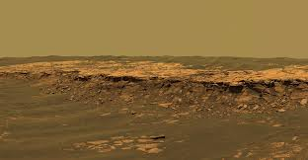
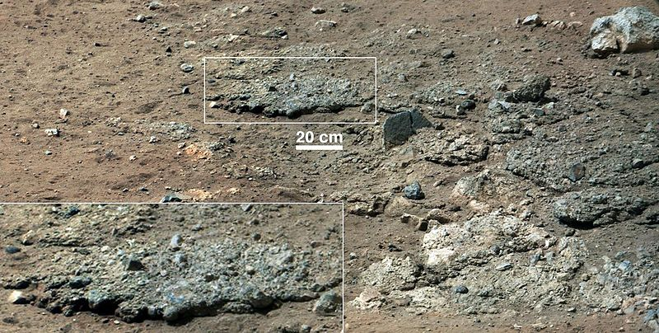
Science objectives of ISEM
Search and study of OH/H₂O-bearing minerals
Geological investigation and study a composition of Martian surface materials (minerals and rocks) in the thin uppermost layer
Identification and mapping of the distribution of all kind of aqueous alteration products on landing site
Real-time assessment of surface composition in selected areas, in support of identifying and selection of the most promising drilling sites
Studies of variations of the atmospheric dust properties and of the atmospheric gaseous composition (hampered by limited number of observation cycles)

Slide 4
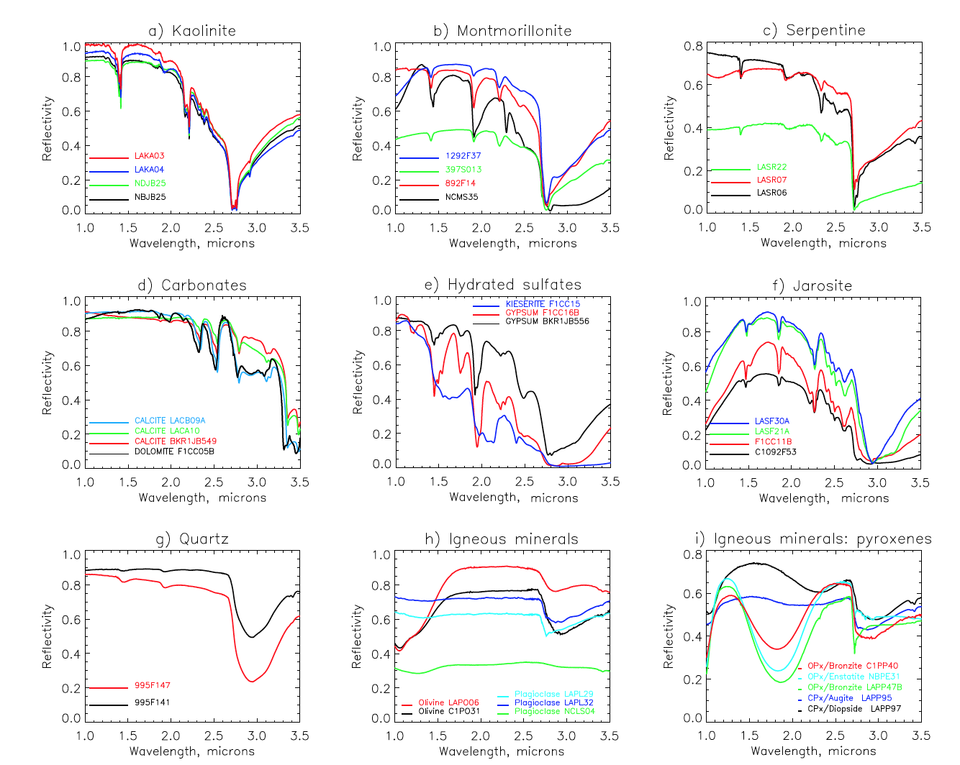
The method

Slide 5
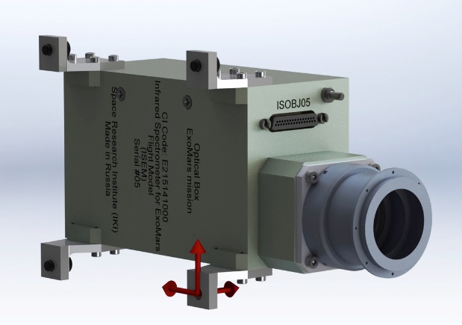
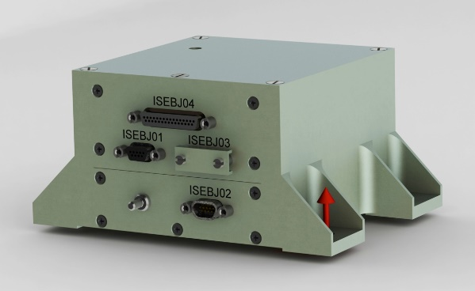
ISEM main parameters
Optical Box (OB) ISEM
Electronic Box (EB) ISEM
Spectral range | 1.15-3.3 µm
Field of view | 1°
Optical point detector | Judson Teledyne J12TE3-66D-R01M, three stage thermoelectrically cooled Ø1 mm
Spectral resolution | 25 cm⁻¹ or better
Power consumption | 12 W ave (14 W peak; 9 W standby)
Operating temperatures | –45°…+30°С (OB); –40°…+50°С (EB)
Storage temperatures | –130°…+60°С (OB); –60°…+60°С (EB) (–130°C confirmed)
Output interface | RS-422
Overall dimension | 80×167×96 mm (optical box with MLI) 92×116×55 mm (electronic box)
Mass breakdown | 1.740 kg overall 0.690 kg optical box (0.63 kg) 0.014 kg calibration target (ISEM share) 0.560 kg electronic box (0.44 kg) 0.476 kg harness estimation (TAS-I data)
Notes:
New alternative detector – more efficient.
Sizes updated – MLI and manufacturing requirements were taken into account
Mass estimation updated – instrument become heavier almost 500 g then at the beginning

Slide 6
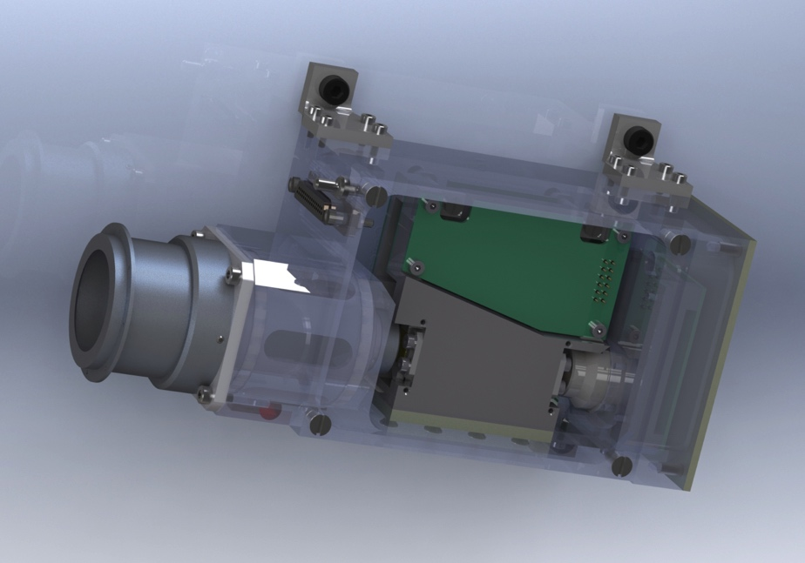
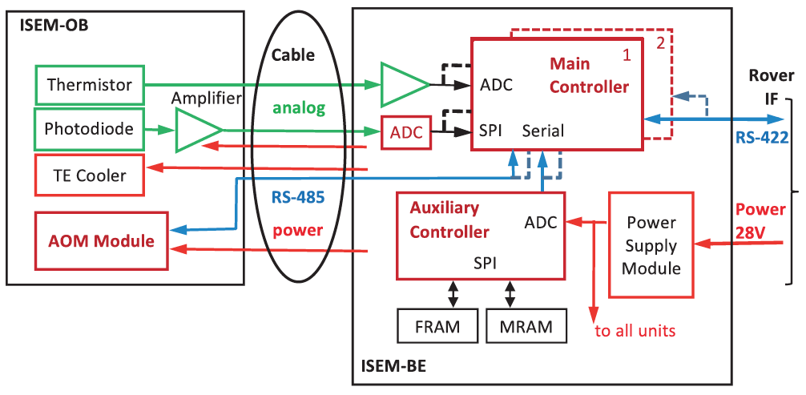
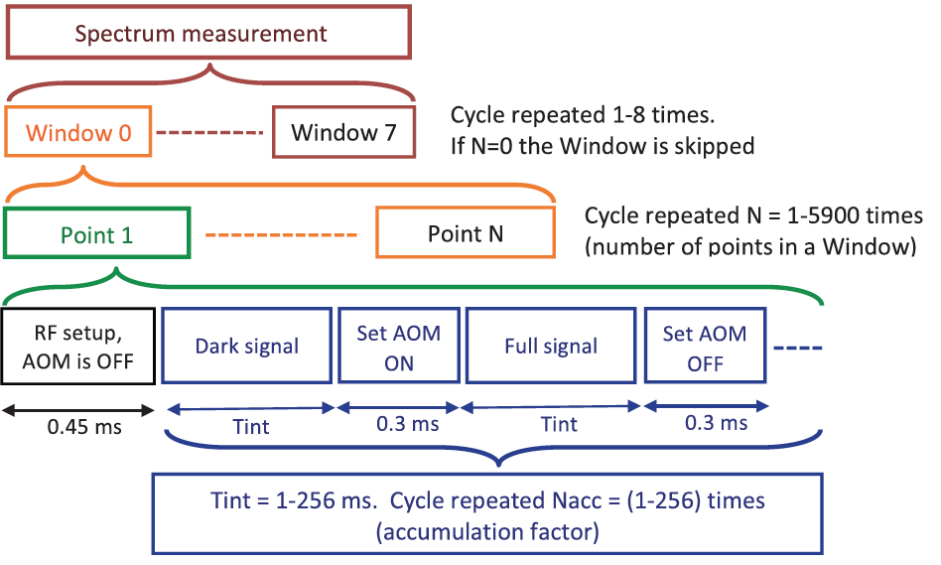
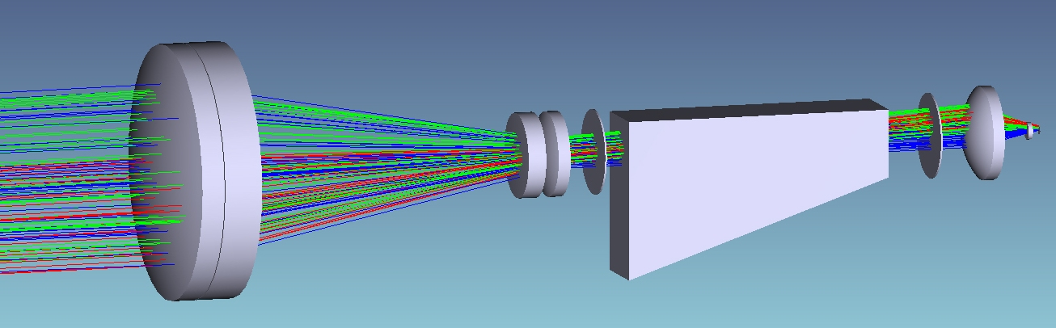
ISEM Implementation
OB: 3D model
Blend
AOTF
Block diagram
Entrance optics
Detector
Optical scheme
Polarizers
AOTF
Entrance optics
Detector
Measurement cycle
Notes:
The optical scheme includes entry optics, the TeO2 AOTF, and a Peltier-cooled Indium arsenide detector.

Slide 7
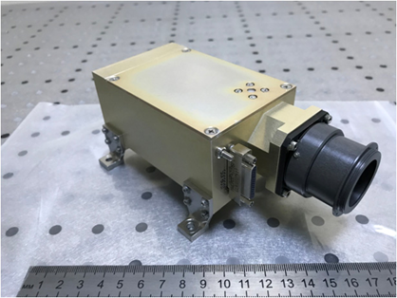
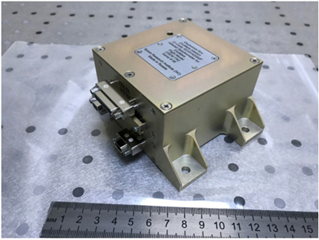
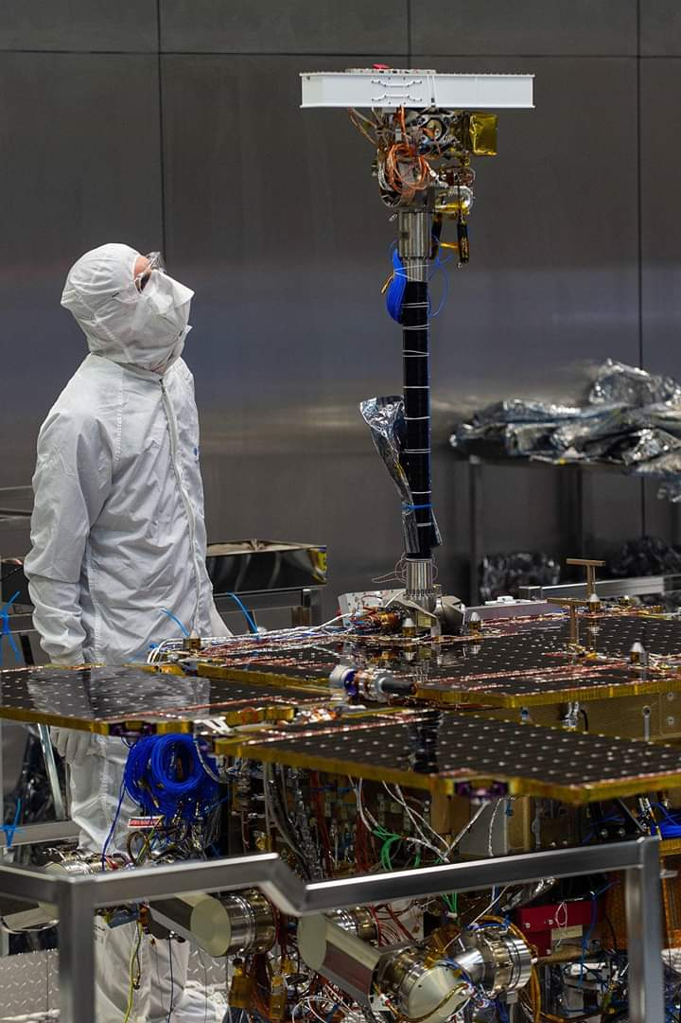
ISEM FM
Delivered in 2018
Electronic Box (ISEM EB) integrated to the rover in April 2019
Optical Box (ISEM OB) installed on DMA in June 2019
In November 2019 ISEM FM passed TV tests as a part of Rover PFM
For unknown reason, ISEM heating was not switched on at low temperatures.
Efficiency of the heating remains unknown!

Slide 8
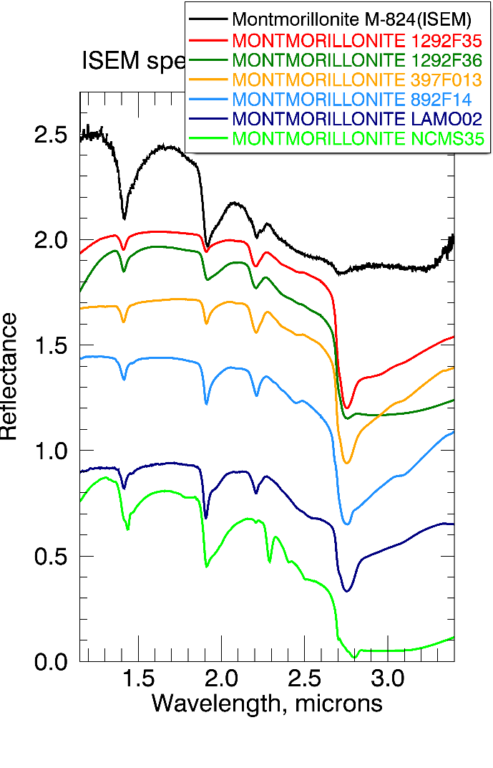
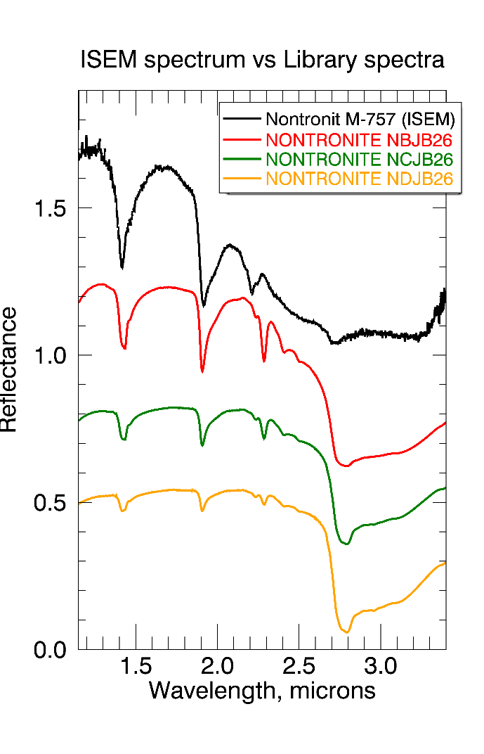
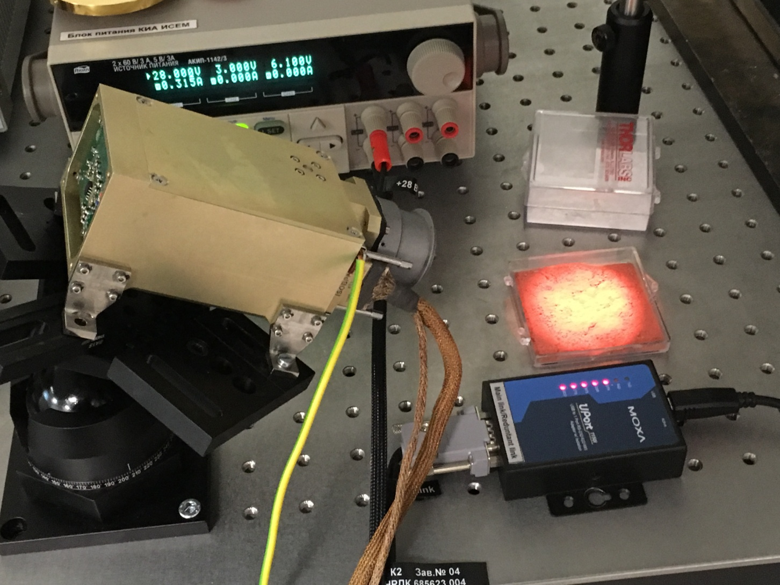
Testing ISEM EQM 2 in the lab and the spectra obtained

Slide 9
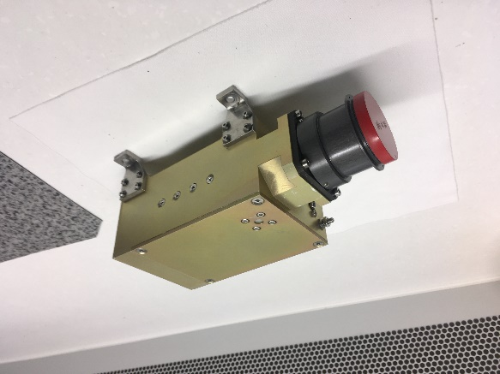
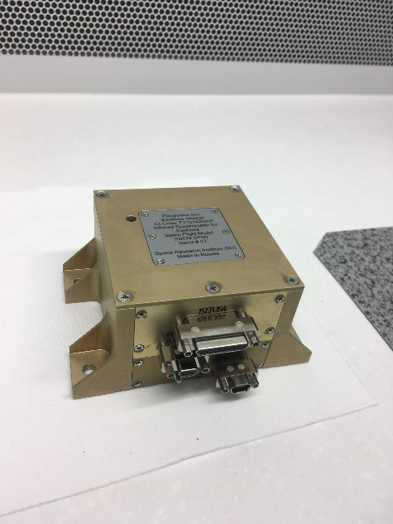
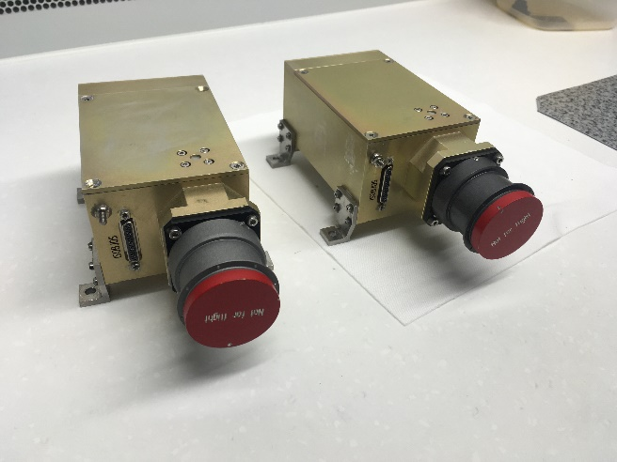
ISEM Flight Spare model (ISEM FS)
ISEM FS assembled and passed acceptance tests at IKI (including TV tests down to -130℃) and calibrations in November 2019.
Ready for work and for possible change
ISEM FS (right) and ISEM EQM2
at IKI lab

Slide 10

ISEM FM vs ISEM FS
1.15 – 3.4 Spectral range, µm 1.15 – 3.4
22-23 Spectral resolution, cm⁻¹ 19-22 (!)
1.0 Field of view (at half-max), degrees 1.05
ISEM FS has better acousto-optic performance, which means higher optical signal at the detector at the same level of power consumption
ISEM FS software allows operating at very short exposure times (possibility of direct Sun measurements). ISEM FM needs reprogramming for this option
Any possibility of replacing?? At least Optical Box…

Slide 11
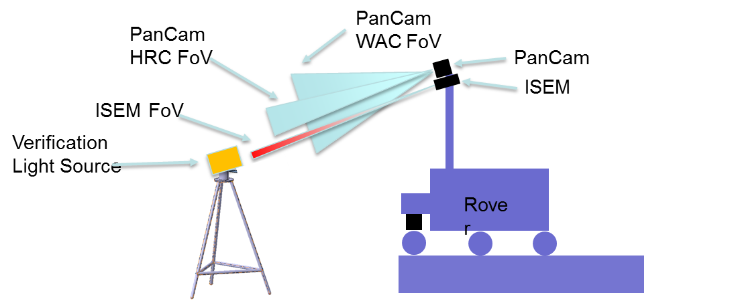
Current and upcoming activities/plans/risks
ISEM FM further testing with Rover PFM
ISEM FM cross-calibrations with PanCam (most waited!)
ISEM EQM1 further testing with Rover GTM
ISEM EQM2 measurement activities at IKI
ISEM FS further analysis at IKI, delivery TBC
What about heating?? – Yes, ISEM is qualified for storage temperatures down to -130℃ (EQM2, FM and FS) but it is still supposed to be heated to prevent this!

Slide 12
Publications
Papers
Dobrolenskiy et al., Acousto-optic spectrometer ISEM for ExoMars-2020 space mission: ground measurements and calibrations, Proc. of SPIE, Vol. 11210, p. 1121002-1 (2019) – just published!
Korablev et al., Acousto-optic tunable filter spectrometers in space missions, Applied Optics, 57 (10), C103 (2018)
O. Korablev et al. Infrared Spectrometer for ExoMars: A Mast-Mounted Instrument for the Rover, Astrobiology, 17:6-7, 542 (2017).
Conferences
European Planetary Science Congress 2019 (EPSC-DPS Joint Meeting 2019). Geneva, Switzerland, 2019
14th School on Acousto-Optics and Applications. Torun, Poland, 2019

